Slide 1
IOT 4117: IoT Architecture and Technologies
Md. Habibur Rahman
Lecturer
Department of ICT, BDU

Slide 2

Chapter 20
Network Layer:
Internet Protocol
Copyright © The McGraw-Hill Companies, Inc. Permission required for reproduction or display.

Slide 3
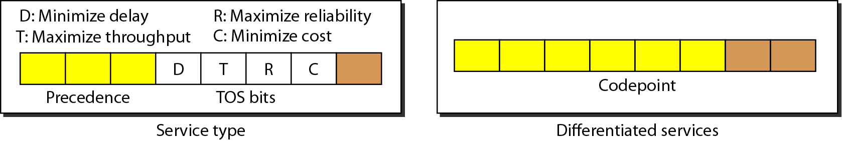
Figure 20.6 Service type or differentiated services

Slide 4
Header Fields (2)
Services
the IETF has changed the interpretation and name of this 8-bit field.
“differentiated services” was your homework.
The first 6 bits make up the code-point subfield.
The last 2 bits are not used.
The code-point subfield can be used in two different ways.

Slide 5

Service Type(a)
When the 3 rightmost bits are O’s, then
The first 3 bits are Precedence bits.
The last 2 bits is not used
Precedence:
Value ranges from 000 to 111.
Defines priority of the datagram
Used in situations of Network Congestion
Router discards datagrams of low precedence in case of congestion.
The value of TOS interpretation XXXOOO (which includes 0, 8, 16, 24, 32, 40, 48, and 56)

Slide 6
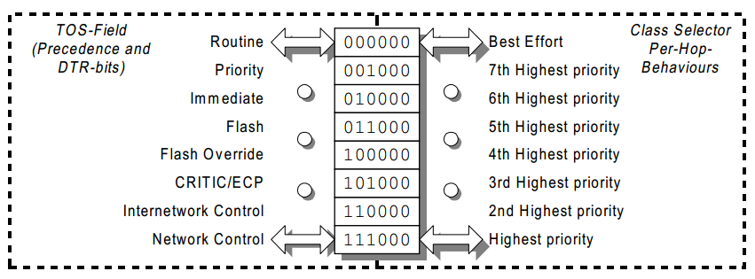
Figure DS.1 Usage of DS-field in Class Selector PHB
Notes:
SCTP- Stream Control Transmission Protocol

Slide 7

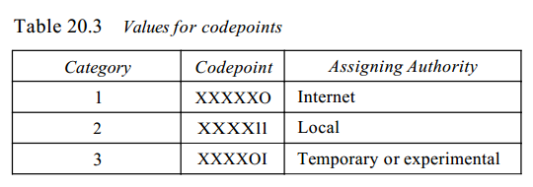
Service Type(b)
When the 3 rightmost bits are not all O’s
The 6 bits define 64 services based on the
priority assignment by the Internet or local authorities according to Table 20.3

Slide 8

Category 1
The first category contains 32 service types.
The first category (numbers 0, 2, 4, ... , 62) is assigned by the Internet authorities (IETF).
The first category would range from 0 to 31

Slide 9

Category 2
The second category contains 16 service types.
The second category (3, 7, 11, 15, … , 63) can be used by local authorities (organizations).
The second category would range from 32 to 47

Slide 10

Category 3
The third category contains 16 service types.
The third category (1, 5, 9, … , 61) is temporary and can be used for experimental purposes
The third category would range from 48 to 63

